Slide 1
Data Pre-Processing-IV (Data Reduction- SVD, LDA)
Dr. Jasmeet singh
Assistant Professor, CSED
TIET, Patiala

Slide 2
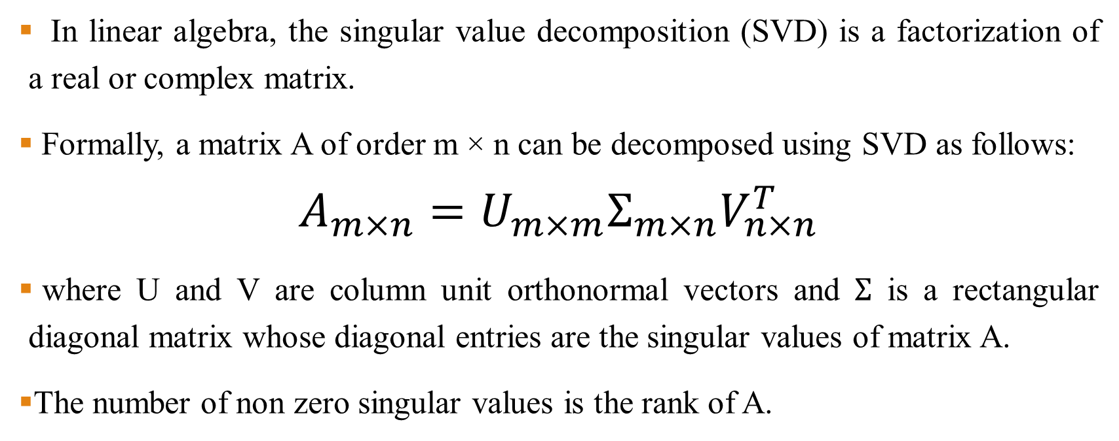
Singular Valued Decomposition (SVD)
In linear algebra, the singular value decomposition (SVD) is a factorization of a real or complex matrix.
Formally, a matrix A of order m × n can be decomposed using SVD as follows:
$$A_{m×n}={U_{m×m}Σ}_{m×n}V_{n×n}^{T}$$
where U and V are column unit orthonormal vectors and $Σ$ is a rectangular diagonal matrix whose diagonal entries are the singular values of matrix A.
The number of non zero singular values is the rank of A.

Slide 3
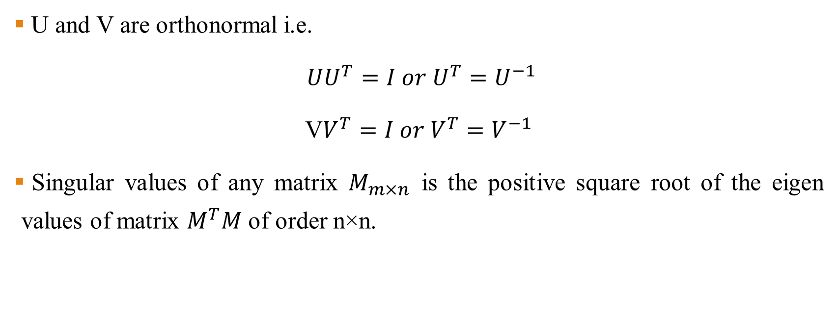
Singular Valued Decomposition- Contd…
U and V are orthonormal i.e.
$UU^{T}=I or U^{T}=U^{−1}$
V$V^{T}=I or V^{T}=V^{−1}$
Singular values of any matrix $M_{m×n}$ is the positive square root of the eigen values of matrix $M^{T}M$ of order n×n.

Slide 4
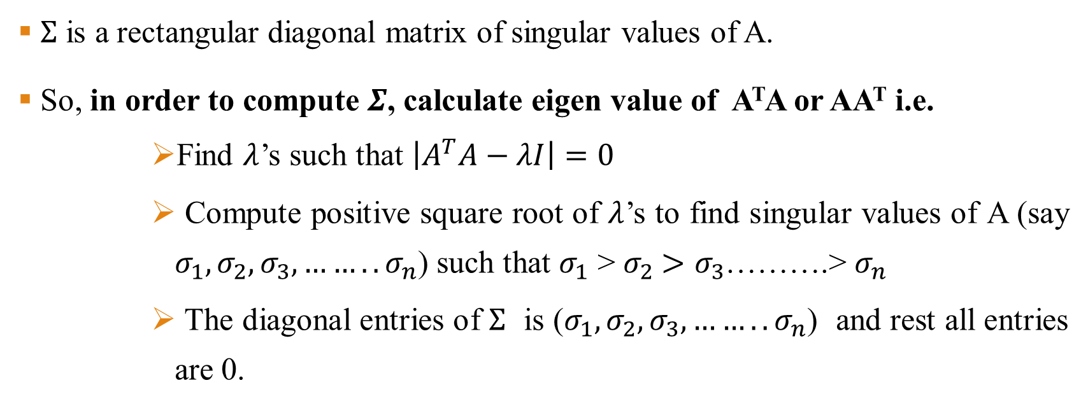

How to Compute U, $Σ$, and V ?
$Σ$ is a rectangular diagonal matrix of singular values of A.
So, in order to compute $Σ$, calculate eigen value of A^{T}A or AA^{T} i.e.
Find $λ$’s such that $\left|A^{T}A−λI\right|=0$
Compute positive square root of $λ$’s to find singular values of A (say $σ_{1},σ_{2},σ_{3}, ……..σ_{n}$) such that $σ_{1}$ > $σ_{2}$ $>σ_{3}$……….> $σ_{n}$
The diagonal entries of $Σ$ is ($σ_{1},σ_{2},σ_{3}, ……..σ_{n}$) and rest all entries are 0.

Slide 5
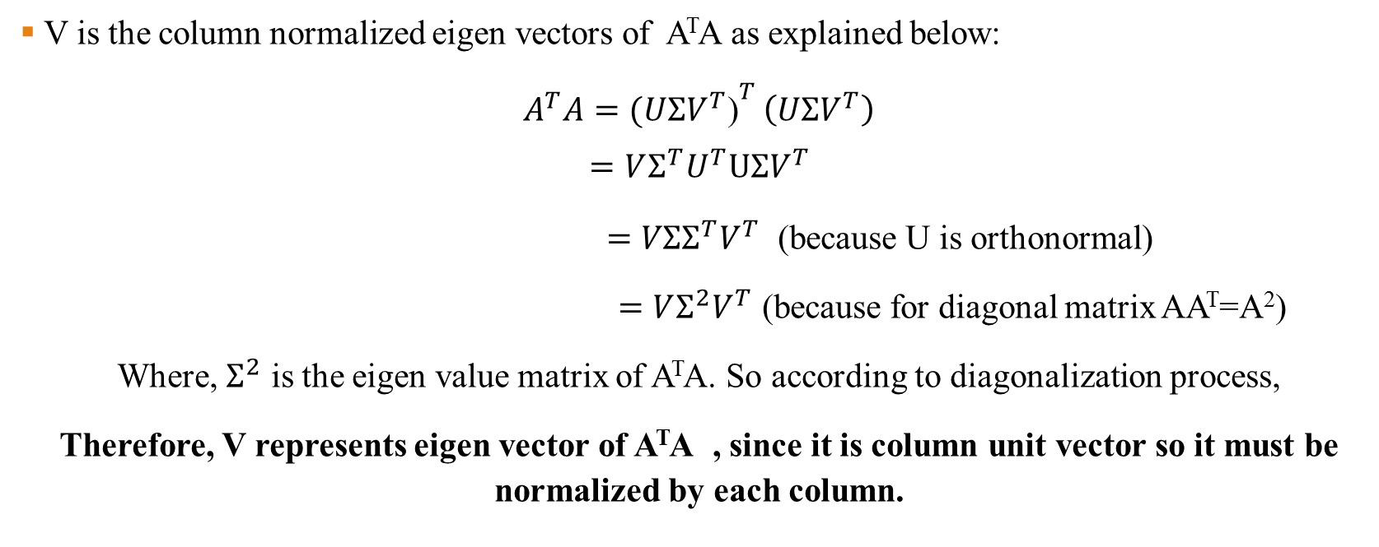
How to Compute U, $Σ$, and V ?
V is the column normalized eigen vectors of A^{T}A as explained below:
$A^{T}A={(UΣV^{T}\text{)}}^{T}$ $\left(UΣV^{T}\right)$
$$=VΣ^{T}U^{T}UΣV^{T}$$
$=VΣΣ^{T}V^{T}$ (because U is orthonormal)
$=VΣ^{2}V^{T}$ (because for diagonal matrix AA^{T}=A²)
Where, $Σ^{2}$ is the eigen value matrix of A^{T}A. So according to diagonalization process,
Therefore, V represents eigen vector of A^{T}A , since it is column unit vector so it must be normalized by each column.

Slide 6

How to Compute U, $Σ$, and V ?
U is the column normalized eigen vectors of AA^{T} as explained below:
$$AA^{T}=\left(UΣV^{T}\right){(UΣV^{T}\text{)}}^{T}$$
$=$ $UΣV^{T}VΣ^{T}U^{T}$
$=UΣΣ^{T}U^{T}$ (because V is orthonormal)
$=UΣ^{2}U^{T}$ (because for diagonal matrix AA^{T}=A²)
Where, $Σ^{2}$ is the eigen value matrix of AA^{T}. So according to diagonalization process,
Therefore, U represents eigen vector of AA^{T} , since it is column unit vector so it must be normalized by each column.

Slide 7
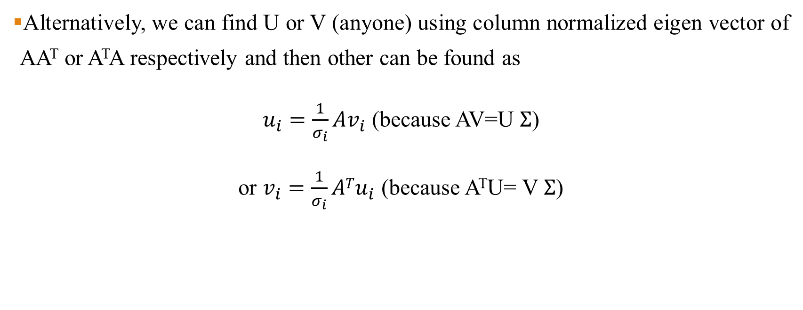
How to Compute U, $Σ$, and V ?
Alternatively, we can find U or V (anyone) using column normalized eigen vector of AA^{T} or A^{T}A respectively and then other can be found as
$u_{i}=\frac{1}{σ_{i}}Av_{i}$ (because AV=U $Σ$)
or $v_{i}=\frac{1}{σ_{i}}ATu_{i}$ (because A^{T}U= V $Σ$)

Slide 8

SVD Example
Find the SVD of A, UΣV ^{T} , where
$A=\left(\begin{matrix}3 & 2 & 2 \\ 2 & 3 & −2\end{matrix}\right)$

Slide 9
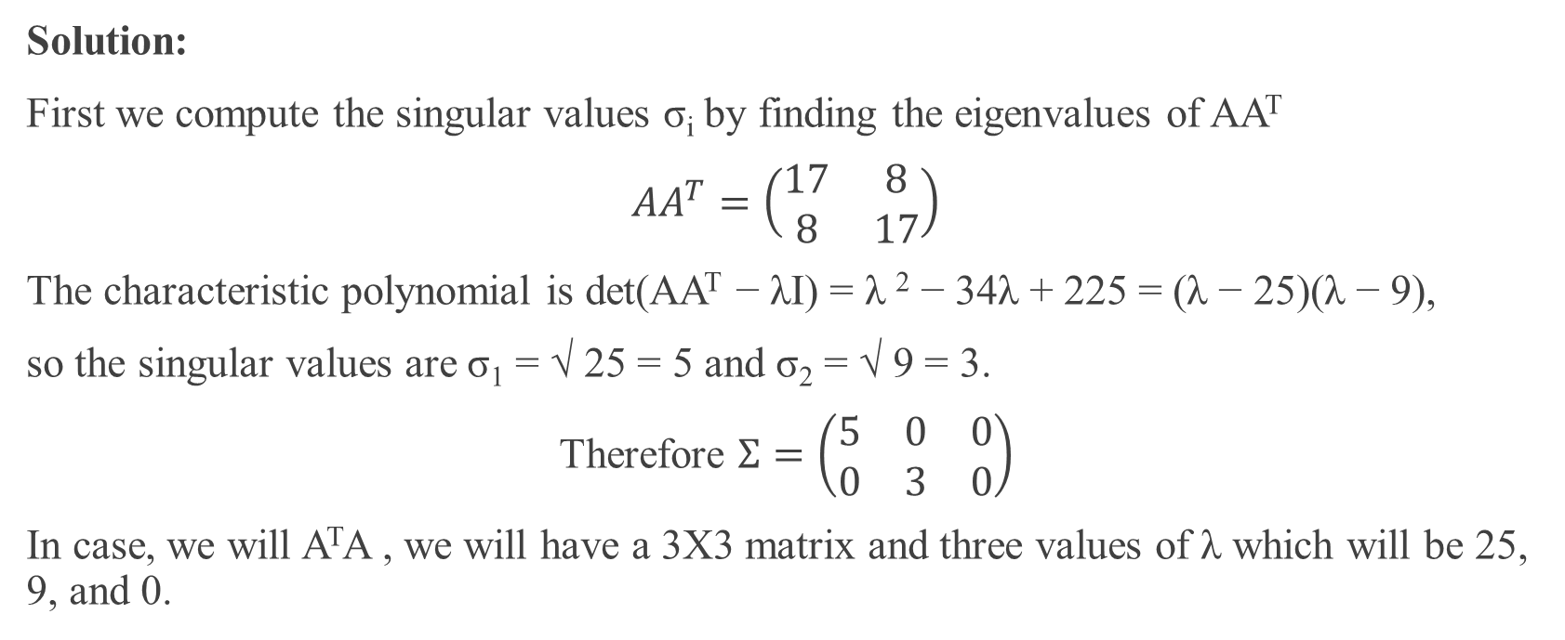
SVD Example
Solution:
First we compute the singular values σ_{i} by finding the eigenvalues of AA^{T}
$AA^{T}=\left(\begin{matrix}17 & 8 \\ 8 & 17\end{matrix}\right)$
The characteristic polynomial is det(AA^{T} − λI) = λ ² − 34λ + 225 = (λ − 25)(λ − 9),
so the singular values are σ₁ = √ 25 = 5 and σ₂ = √ 9 = 3.
Therefore $Σ=\left(\begin{matrix}5 & 0 & 0 \\ 0 & 3 & 0\end{matrix}\right)$
In case, we will A^{T}A , we will have a 3X3 matrix and three values of λ which will be 25, 9, and 0.

Slide 10
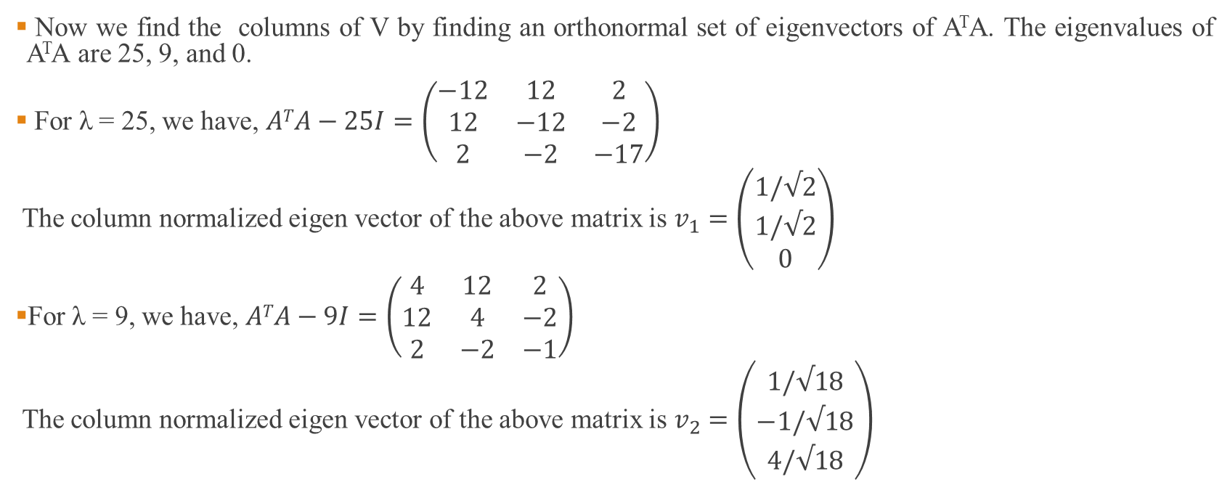
SVD Example
Now we find the columns of V by finding an orthonormal set of eigenvectors of A^{T}A. The eigenvalues of A^{T}A are 25, 9, and 0.
For λ = 25, we have, $ATA−25I=\left(\begin{matrix}−12 & 12 & 2 \\ 12 & −12 & −2 \\ 2 & −2 & −17\end{matrix}\right)$
The column normalized eigen vector of the above matrix is $v_{1}=\left(\begin{matrix}1/√2 \\ 1/√2 \\ 0\end{matrix}\right)$
For λ = 9, we have, $ATA−9I=\left(\begin{matrix}4 & 12 & 2 \\ 12 & 4 & −2 \\ 2 & −2 & −1\end{matrix}\right)$
The column normalized eigen vector of the above matrix is $v_{2}=\left(\begin{matrix}1/√18 \\ −1/√18 \\ 4/√18\end{matrix}\right)$

Slide 11

SVD Example
For λ = 0, we have, $ATA=\left(\begin{matrix}13 & 12 & 2 \\ 12 & 13 & −2 \\ 2 & −2 & 8\end{matrix}\right)$
The column normalized eigen vector of the above matrix is $v_{2}=\left(\begin{matrix}2/3 \\ −2/3 \\ 1/3\end{matrix}\right)$
Therefore, $V=\left(\begin{matrix}1/√2 & 1/√18 & 2/3 \\ 1/√2 & −1/√18 & −2/3 \\ 0 & 4/√18 & 1/3\end{matrix}\right)$

Slide 12
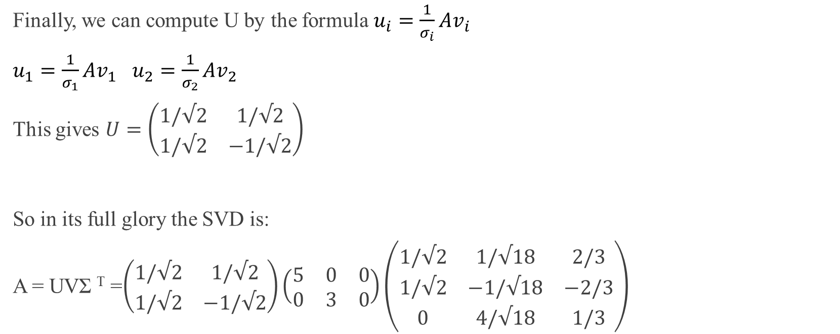
SVD Example
Finally, we can compute U by the formula $u_{i}=\frac{1}{σ_{i}}Av_{i}$
$u_{1}=\frac{1}{σ_{1}}Av_{1}$ $u_{2}=\frac{1}{σ_{2}}Av_{2}$
This gives $U=\left(\begin{matrix}1/√2 & 1/√2 \\ 1/√2 & −1/√2\end{matrix}\right)$
So in its full glory the SVD is:
A = UVΣ ^{T} =$\left(\begin{matrix}1/√2 & 1/√2 \\ 1/√2 & −1/√2\end{matrix}\right)\left(\begin{matrix}5 & 0 & 0 \\ 0 & 3 & 0\end{matrix}\right)\left(\begin{matrix}1/√2 & 1/√18 & 2/3 \\ 1/√2 & −1/√18 & −2/3 \\ 0 & 4/√18 & 1/3\end{matrix}\right)$

Slide 13
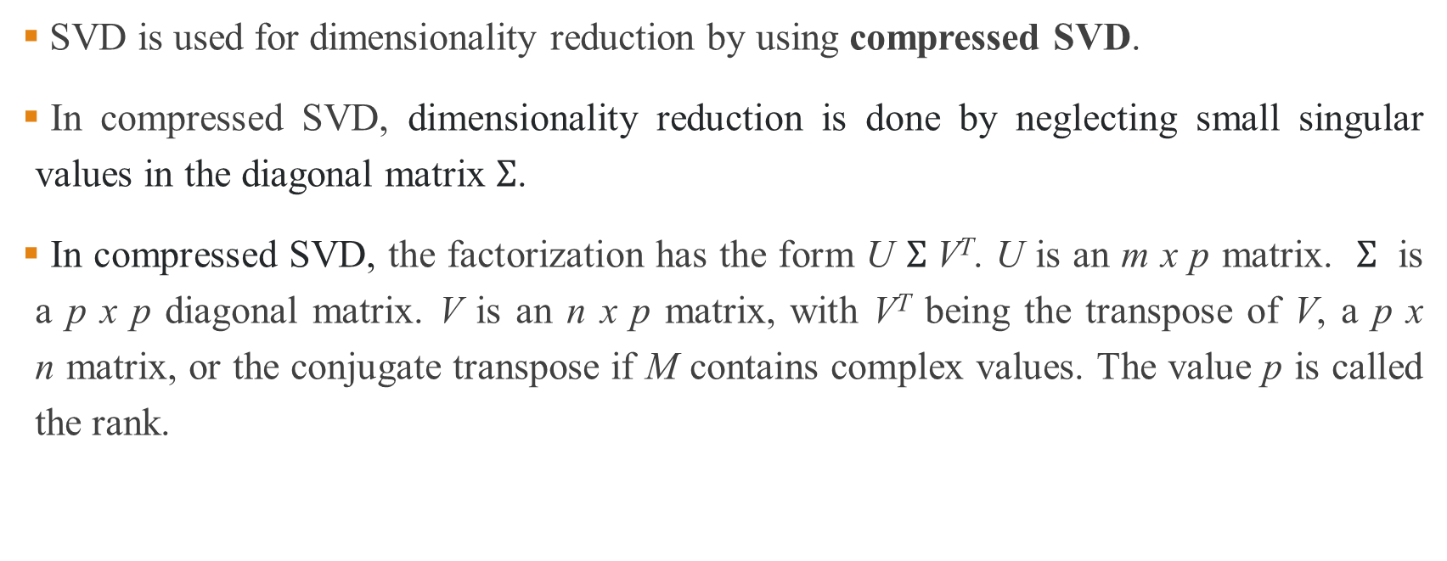
SVD for Dimensionality Reduction
SVD is used for dimensionality reduction by using compressed SVD.
In compressed SVD, dimensionality reduction is done by neglecting small singular values in the diagonal matrix $Σ$.
In compressed SVD, the factorization has the form U $Σ$V^{T}. U is an m x p matrix. $Σ$ is a p x p diagonal matrix. V is an n x p matrix, with V^{T} being the transpose of V, a p x n matrix, or the conjugate transpose if M contains complex values. The value p is called the rank.

Slide 14
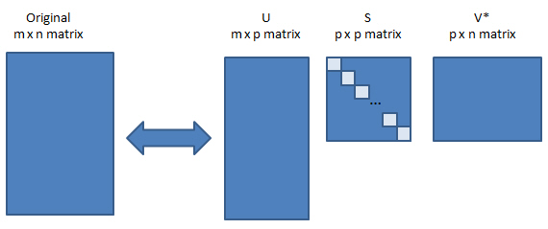
SVD for Dimensionality Reduction

Slide 15
Applications of SVD
SVD, might be the most popular technique for dimensionality reduction when data is sparse.
Sparse data refers to rows of data where many of the values are zero.
This is often the case in some problem domains like recommender systems where a user has a rating for very few movies or songs in the database and zero ratings for all other cases.
Another common example is a bag of words model of a text document, where the document has a count or frequency for some words and most words have a 0 value.

Slide 16
Applications of SVD
Examples of sparse data appropriate for applying SVD for dimensionality reduction:
Recommender Systems
Customer-Product purchases
User-Song Listen Counts
User-Movie Ratings
Text Classification
One Hot Encoding
Bag of Words Counts
TF/IDF

Slide 17
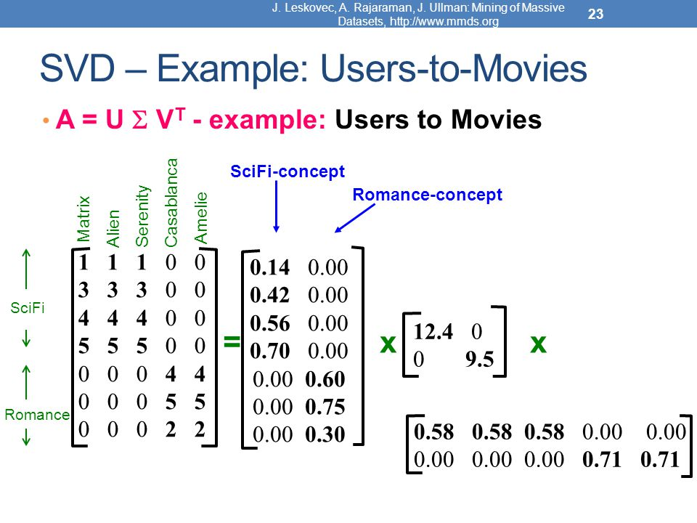
Applications of SVD

